Slide 1
The Effects of Family Instability on Adolescents’ Sexual Initiation
Jessie Neel

Slide 2
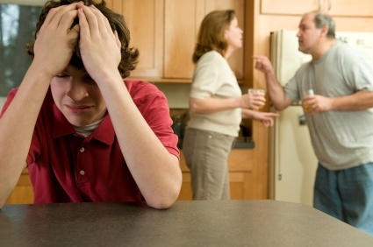
Research Question
Does family instability affect adolescents’ age at sexual initiation?

Slide 3
Family Structures
Vastly changing over 60 years
Divorce
Stepfamilies
Nonmarital childbirths
Cohabitation
50% of children will spend time in
single-parent homes before 18
40% of children will spend time in
cohabitating families

Slide 4
Family Instability
Defined as adding and exiting of mothers’ partners
Negatively affects adolescents’ well-beings
Family transitions cause changes in
Family income
Parental expectations
Normal routines
Housing locations
Increases adolescents’ levels
of delinquency and depression

Slide 5
Adolescents’ Dating Relationships
Increasing rates of “hooking up”
50% of high school students had sex in nondating relationships
Motivations for adolescents' sexual initiation
Romantic partners
Low income schools
Low rates of parental monitoring
Linked to
Behavioral problems
Substance abuse
School detachment

Slide 6
Family Instability Affecting Adolescents’ Sexual Initiation
Women engaged in sex earlier if they experienced family instability and transitions
More frequent family transitions influence earlier age of adolescents’ sexual initiation
Why?
Socialization perspective
Different beliefs on nonmarital sex
Social control perspective
Different amounts of exposure to sex
Instability and control perspective
Different amounts of stress due to instability

Slide 7
Suggestions for Future Research
Will “hooking up” eventually overshadow dating relationships?
Does family instability have a similar influence on the age of adolescents’ marriage?
Do adolescents who have experienced more family instability divorce and marry more often?

